Slide 1

Machine Learning with Azure
(… Winning Sports Bets with the Cloud)
Notes:
We are focused on changing the framework to which clients look at their current opportunities–to see something in their business opportunity that they cannot see and/or contemplate for themselves. We can offer a different vantage point and really help them think into the business in completely different ways; including, but not limited to looking beyond the particular “issue” that generated the engagement. In doing so, we can open up a different set of future possibilities for their business that transcend the immediate problem they are facing and drive monumental value for their organization and business.
This tagline reinforces our commitment to thinking into our clients’ businesses and elevating their opportunities for success. The opportunity is in taking a proactive approach that goes beyond maybe what is even being asked of us and saying on a daily basis
“How can I add value to my client’s business today and in the future”
“What emerging opportunities exist that I can help them take advantage of?”

Slide 2
Agenda
Introduction to Data Science
What is R?
Statistical Analysis with R
Visual Analysis with R
Demos

Slide 3
What is data science?
Development
Statistics
Business Knowledge
Notes:
Who has heard of it?

Slide 4



emeRgence
Notes:
Who has heard of it?

Slide 5
pRedictive analytics process
Identify a question
Understand the data we have and require
Ingest
Create a model
Deploy and evaluate model
Notes:
First, we find a question that we want to answer. This can be a hypothesis we want to test, a decision we want to decide on, or a prediction we want to make. Second, we explore the data that we have available and the data that we may need to collect. We need to understand what data we have, what data we don't have, and what condition these data are in. Third, we prepare the data for analysis, a process often referred to as data munging or data wrangling. We need to gather, clean, and transform these data to get them into a form suitable for analysis. Fourth, we create a model given our data. In the most generic sense, this can be a numerical model, a visual model, a statistical model, or a machine-learning model. Fifth, we evaluate the model. We need to determine if our model answers our question, helps us make an informed decision, or creates an accurate prediction. In addition, we also need to make sure that the model is appropriate, given our data and the context. Finally, if everything looks good, we deploy our model.

Slide 6

Notes:
Who has heard of it?

Slide 7
Open source
Actively supported
Provides numerical and visual analysis of data
Notes:
Programming language S -> From Bell labs
Both the development language and the platform
Visualization and analysis tools
Runs on Windows, Mac, and Linux

Slide 8
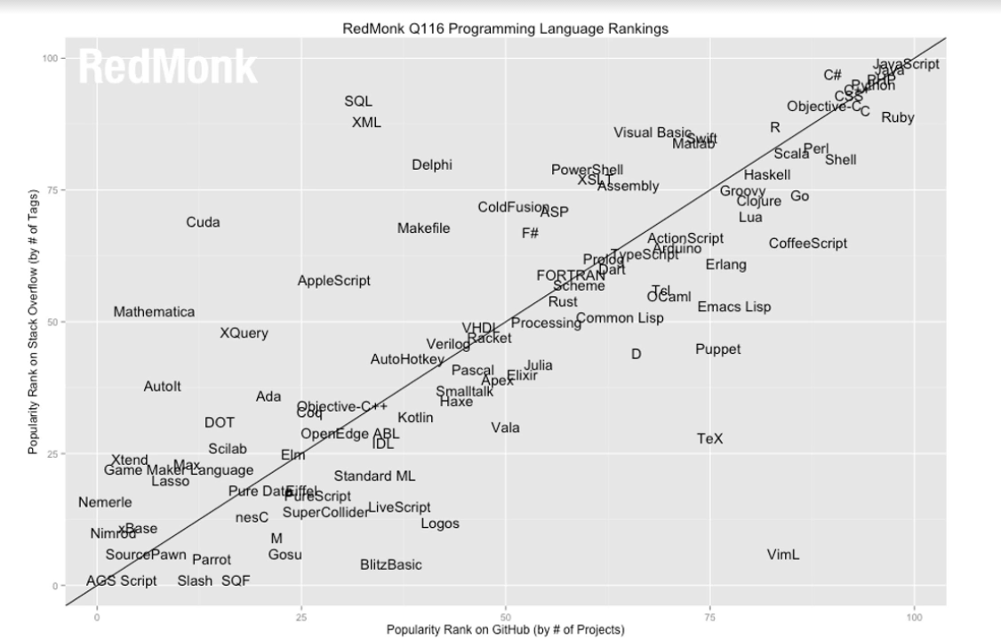
Notes:
Super popular

Slide 9



Tools

Slide 10
paRadigms
Language | Characteristics
C#/Java | Imperative, static
PERL | Interpreted, Dynamics
SQL | Set-based, data-centric
R | Vector, data table based

Slide 11
Concepts in R
Provides both statistical and visual analytics for data
Similar to high level functional languages (functions are a high-level constructs)
Offers a variety of utility data structures, designed to support data analytics

Slide 12
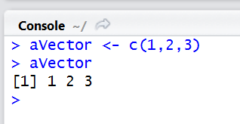
VectoRs
A vector is a one-dimensional array of similar data types

Slide 13
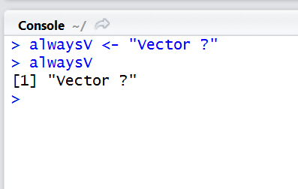
VectoRs
Everything is a vector

Slide 14
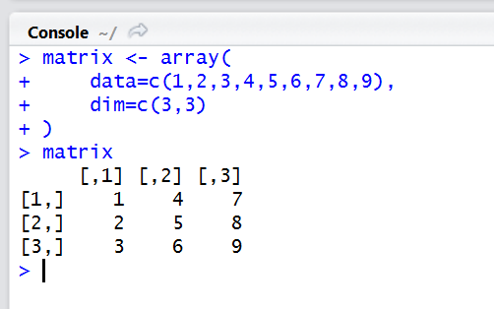
matriXes
A matrix is a two-dimensional vector

Slide 15
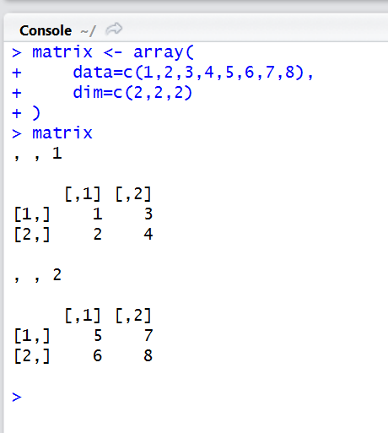
matriXes
Matrixes may be expanded to multiple dimensions

Slide 16
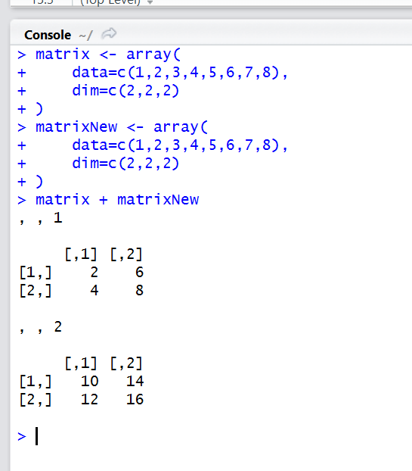
R opeRations
Operations may be performed against vectors and matrixes

Slide 17
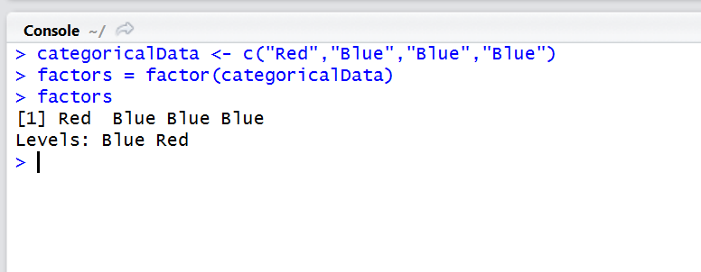
FactoRs & levels
Categorical data is managed as factors in R
Levels are the in memory representation of this construct

Slide 18
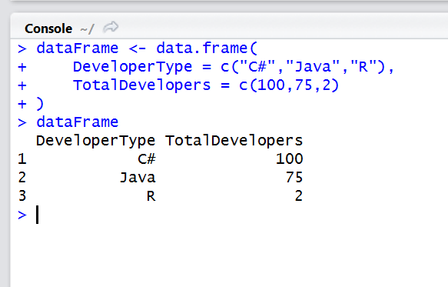
Data fRames
Foundation of R data structures
Key structure for dealing with tabular data in R (rows and columns of similar types)

Slide 19
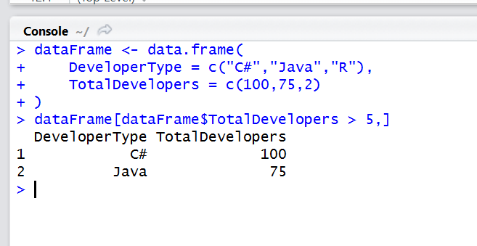
Subsetting
Data frames may be queried (subset) by a variety of programmatic and static functions, including indexers and other complex operations

Slide 20
Package Management
9,000 Packages
Available from command line
Essential for interops

Slide 21
Data opeRations
Ingest
Clean
Transform
Export

Slide 22
Importing data
Files
Databases
Web
Statistical?

Slide 23
Cleaning data with R
Missing value management
Data type consistency
Internal consistency
Column names
Etc.

Slide 24
Exporting data
Native file export
Database
Shiny

Slide 25
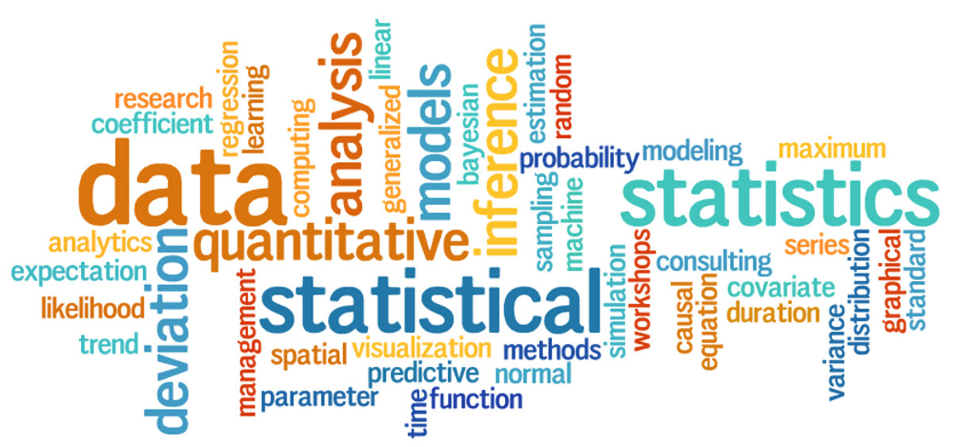
Descriptive statistics

Slide 26
Statistics 101
Observations
Variables
Categorical variable
Numeric Variable

Slide 27
Descriptive statistics
Data definitions
Numerical analysis
Summarization

Slide 28
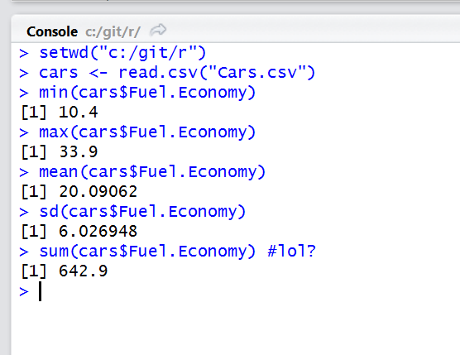
Descriptive statistics

Slide 29
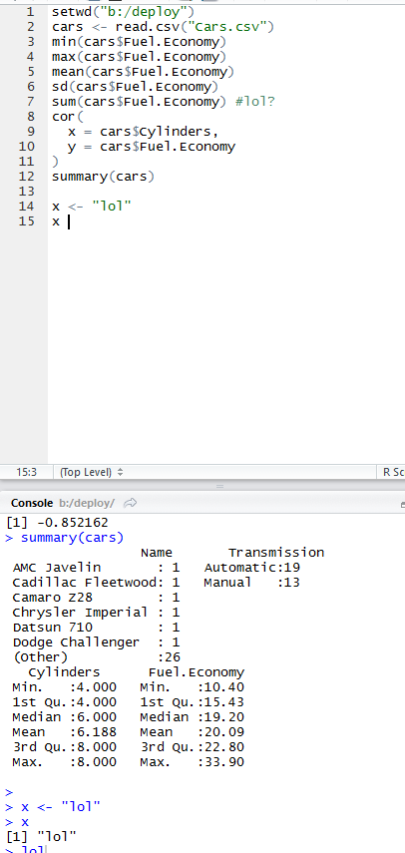
Correlation
Effectiveness of relationship
Correlation coefficient
Unified scale

Slide 30
Correlation
Effectiveness of relationship
Correlation coefficient
Unified scale

Slide 31
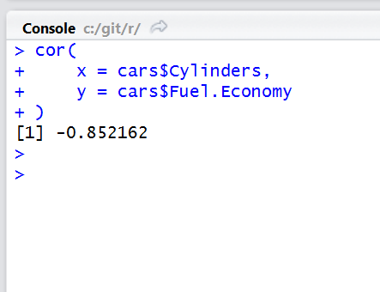
Correlation
Effectiveness of relationship
Correlation coefficient
Unified scale

Slide 32
Visualization

Slide 33
Types of visualization
Bar
Spatial
Network
Multi-dimensional
Network
Interactive

Slide 34
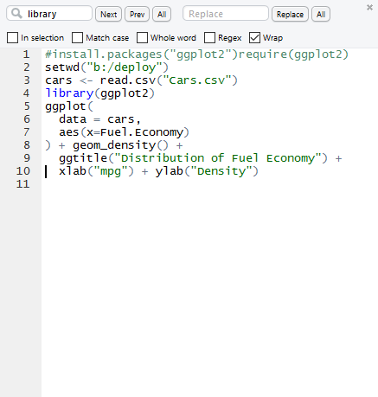
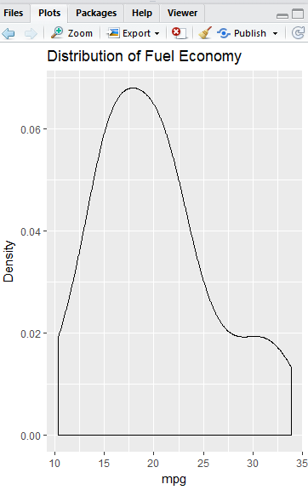
Visualization with R

Slide 35
Delivering R
Point delivery
Applications
Machine learning
R Studio: Shiny

Slide 36
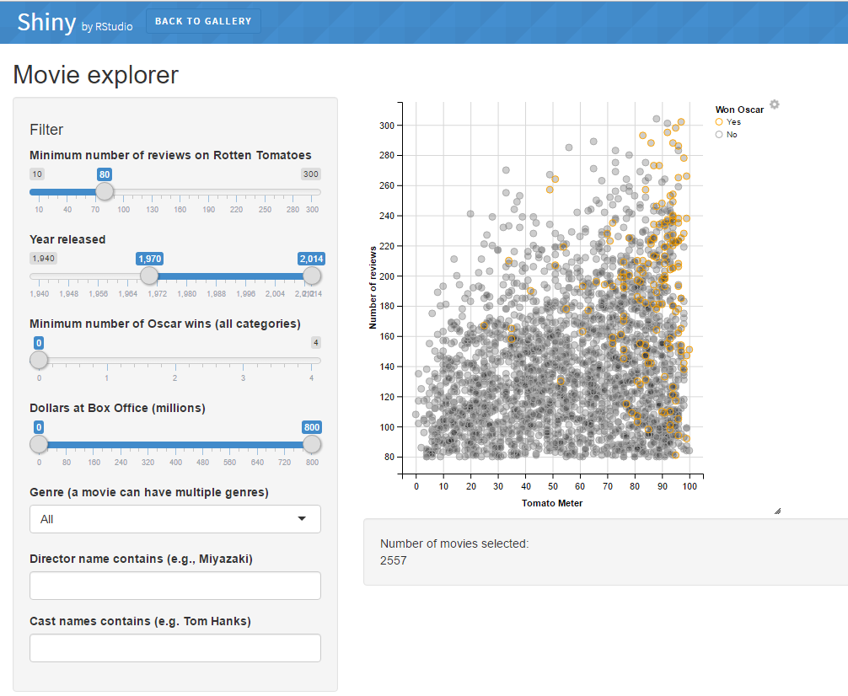

Slide 37



Machine learning and R
Regression
Classification
Clustering

Slide 38
Demonstrations

